Slide 1
Biophysics
BT 301 14 Aug 2023

Slide 2
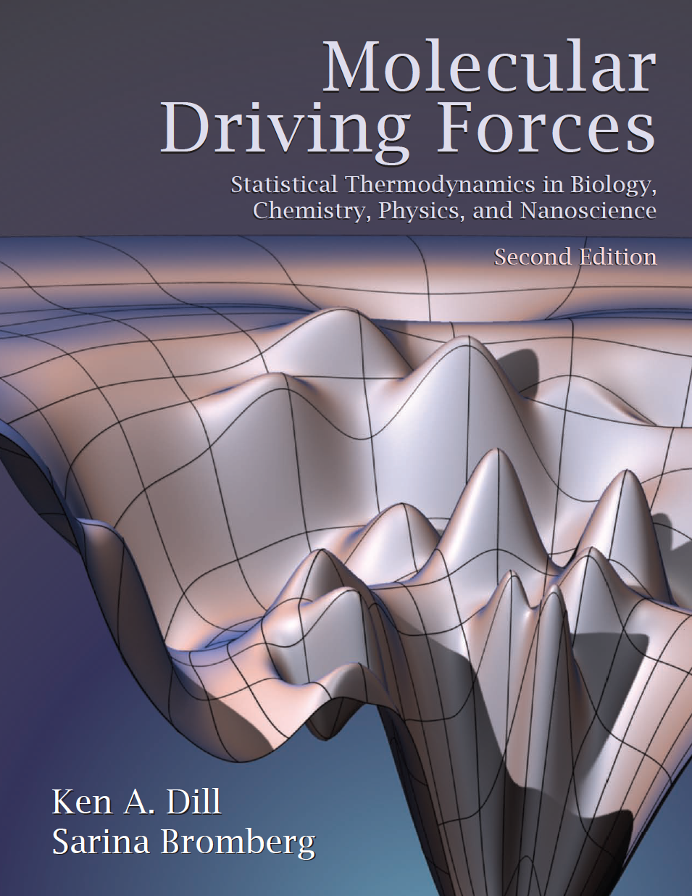
Polymer Elasticity and Collapse

Slide 3
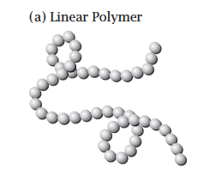
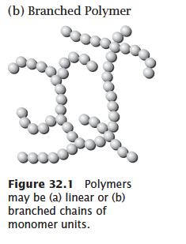
Polymers

Slide 4
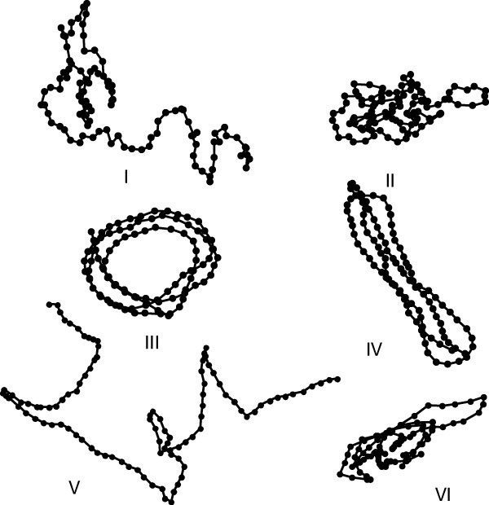
Polymer conformation

Slide 5
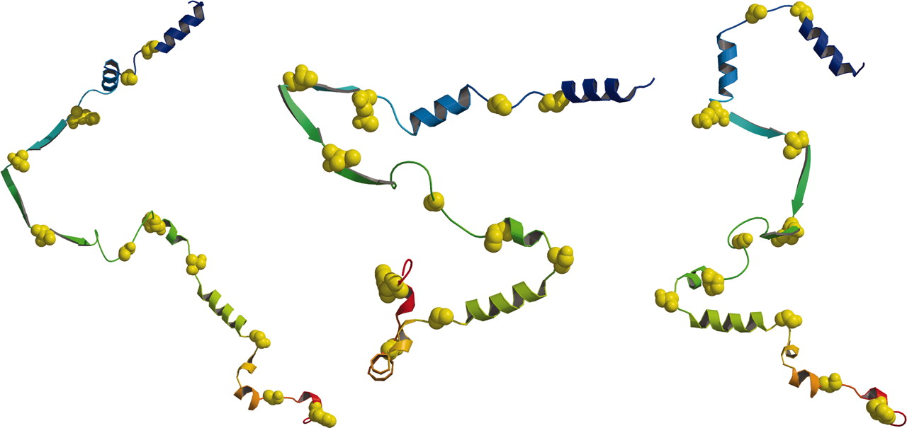
Random coil protein
Reassessing random-coil statistics in unfolded proteins
Nicholas C. Fitzkee and George D. RoseAuthors Info & Affiliations
August 16, 2004 101 (34) 12497-12502 https://doi.org/10.1073/pnas.0404236101

Slide 6
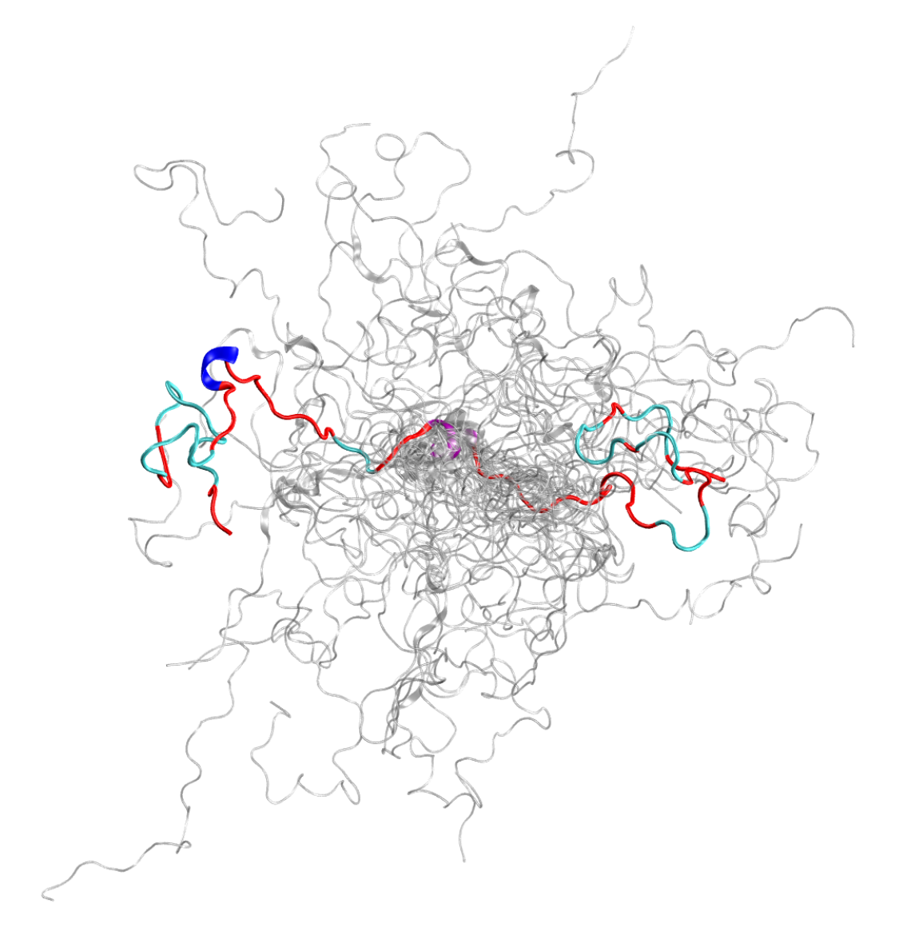
Intrinsically Disordered Protein c-Src Kinase
Using the Titan supercomputer and the Spallation Neutron Source (SNS) at the US Department of Energy’s (DOE’s) Oak Ridge National Laboratory (ORNL), scientists have created the most accurate 3D model yet of an intrinsically disordered protein (IDP), revealing the ensemble of its atomic-level structures.
https://www.olcf.ornl.gov/2019/10/03/titan-supercomputer-and-spallation-neutron-source-unite-to-probe-the-inner-workings-of-c-src-kinase/

Slide 7
Polymer chains can adopt many conformations of equal energy
Each chain can have a different conformation
Measuring polymer conformation experimentally can give us an AVERAGE CONFORMATION.
How can we model this average conformation from theory?

Slide 8
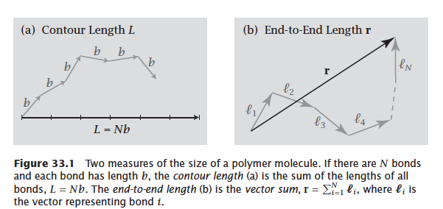
Polymer Chains

Slide 9
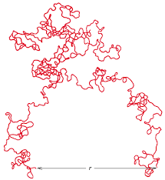
Polymer Chain END-to-END distance

Slide 10
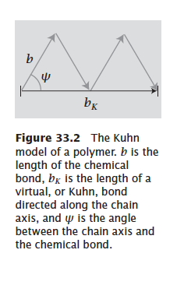
Kuhn Model

Slide 11
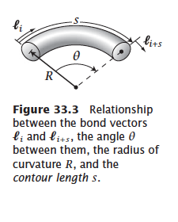
Persistence length related

Slide 12
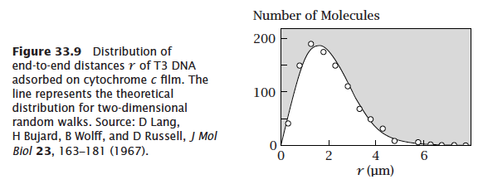
Distribution of end-to-end distances

Slide 13
Polymer conformation depends on the solvent interactions
Theta solvents favour Random Flight conformations
Good solvents promote monomer-solvent interactions favorably over monomer-monomer interactions
Poor solvents favour monomer-monomer interactions over monomer-solvent interactions

